Slide 1


Investigate Business Hotel using Data Visualization
Created by:
Inggriani Priscilia
prisciliainggriani@gmail.com
https://www.linkedin.com/in/inggriani-priscilia-69779b179/
‘I Graduated from Universitas Indonesia in July 2018, majored in Public Health Nutrition. Previously, I finished my internship at Hospital and also Community Service. Right now, I working as a Customer Service. I graduate from Data Science bootcamp at Rakamin with strong analytical thinking and build end to end an experience in Data Science with mini project and virtual internship. I have an knowledge in common data science stacks (SQL, Python, Data Science Libraries).

Slide 2
Overview
“Sangat penting bagi suatu perusahaan untuk selalu menganalisa performa bisnisnya. Pada kesempatan kali ini, kita akan lebih mendalami bisnis dalam bidang perhotelan. Fokus yang kita tuju adalah untuk mengetahui bagaimana perilaku pelanggan kita dalam melakukan pemesanan hotel, dan hubungannya terhadap tingkat pembatalan pemesanan hotel. Hasil dari insight yang kita temukan akan kita sajikan dalam bentuk data visualisasi agar lebih mudah dipahami dan bersifat lebih persuasif. ”

Slide 3
Data Preprocessing
df = pd.read_csv('hotel_bookings_data.csv')
Melakukan pengimportan data
print('Data duplicate pada dataset ini ada',df.duplicated().sum())
Mengecek data duplicate pada dataset ini dan ditemukan sebanyak 33261 data. Dan juga dilakukan drop duplicates.
df1['children']=df1['children'].fillna(0)
df1['city']=df1['city'].fillna('unknown')
df1['agent']=df1['agent'].fillna(0)
df1['company']=df1['company'].fillna(0)
Melihat data kosong pada dataset ini. Ditemukan 4 kolom, yaitu children, city, agent, dan juga company.
Sehingga data kosong tersebut diisi dengan angka 0 pada children, agent dan company. Sedangkan untuk city, diisi unknown.
Untuk selengkapnya, dapat melihat jupyter notebook disini https://colab.research.google.com/drive/1Ne0Pblvb3pTz1nGhX-MmootjCLD5odnd

Slide 4
Data Preprocessing
df1['children']=df1['children'].astype('int64')
df1['agent']=df1['agent'].astype('int64')
df1['company']=df1['company'].astype('int64')
Melakukan perubahan tipe data untuk kolom children, agent, dan company dari float menjadi int
df1['meal']=df1['meal'].replace(['Undefined'],'No Meal')
Merubah data undefined menjadi no meal pada kolom meal karena memiliki arti yang sama
df1['total_guest']=df1['adults']+df1['children']+df1['babies’]
df1['no_night']=df1['stays_in_weekend_nights']+df1['stays_in_weekdays_nights']
Menacari data yang memiliki guest 0 dan tidak menginap (o hari)
df3 = df1[(df1['total_guest'] > 0) & (df1['no_night'] > 0)]
Menghilangkan data yang tidak memiliki guest dan no night
85378
Untuk selengkapnya, dapat melihat jupyter notebook disini https://colab.research.google.com/drive/1Ne0Pblvb3pTz1nGhX-MmootjCLD5odnd

Slide 5
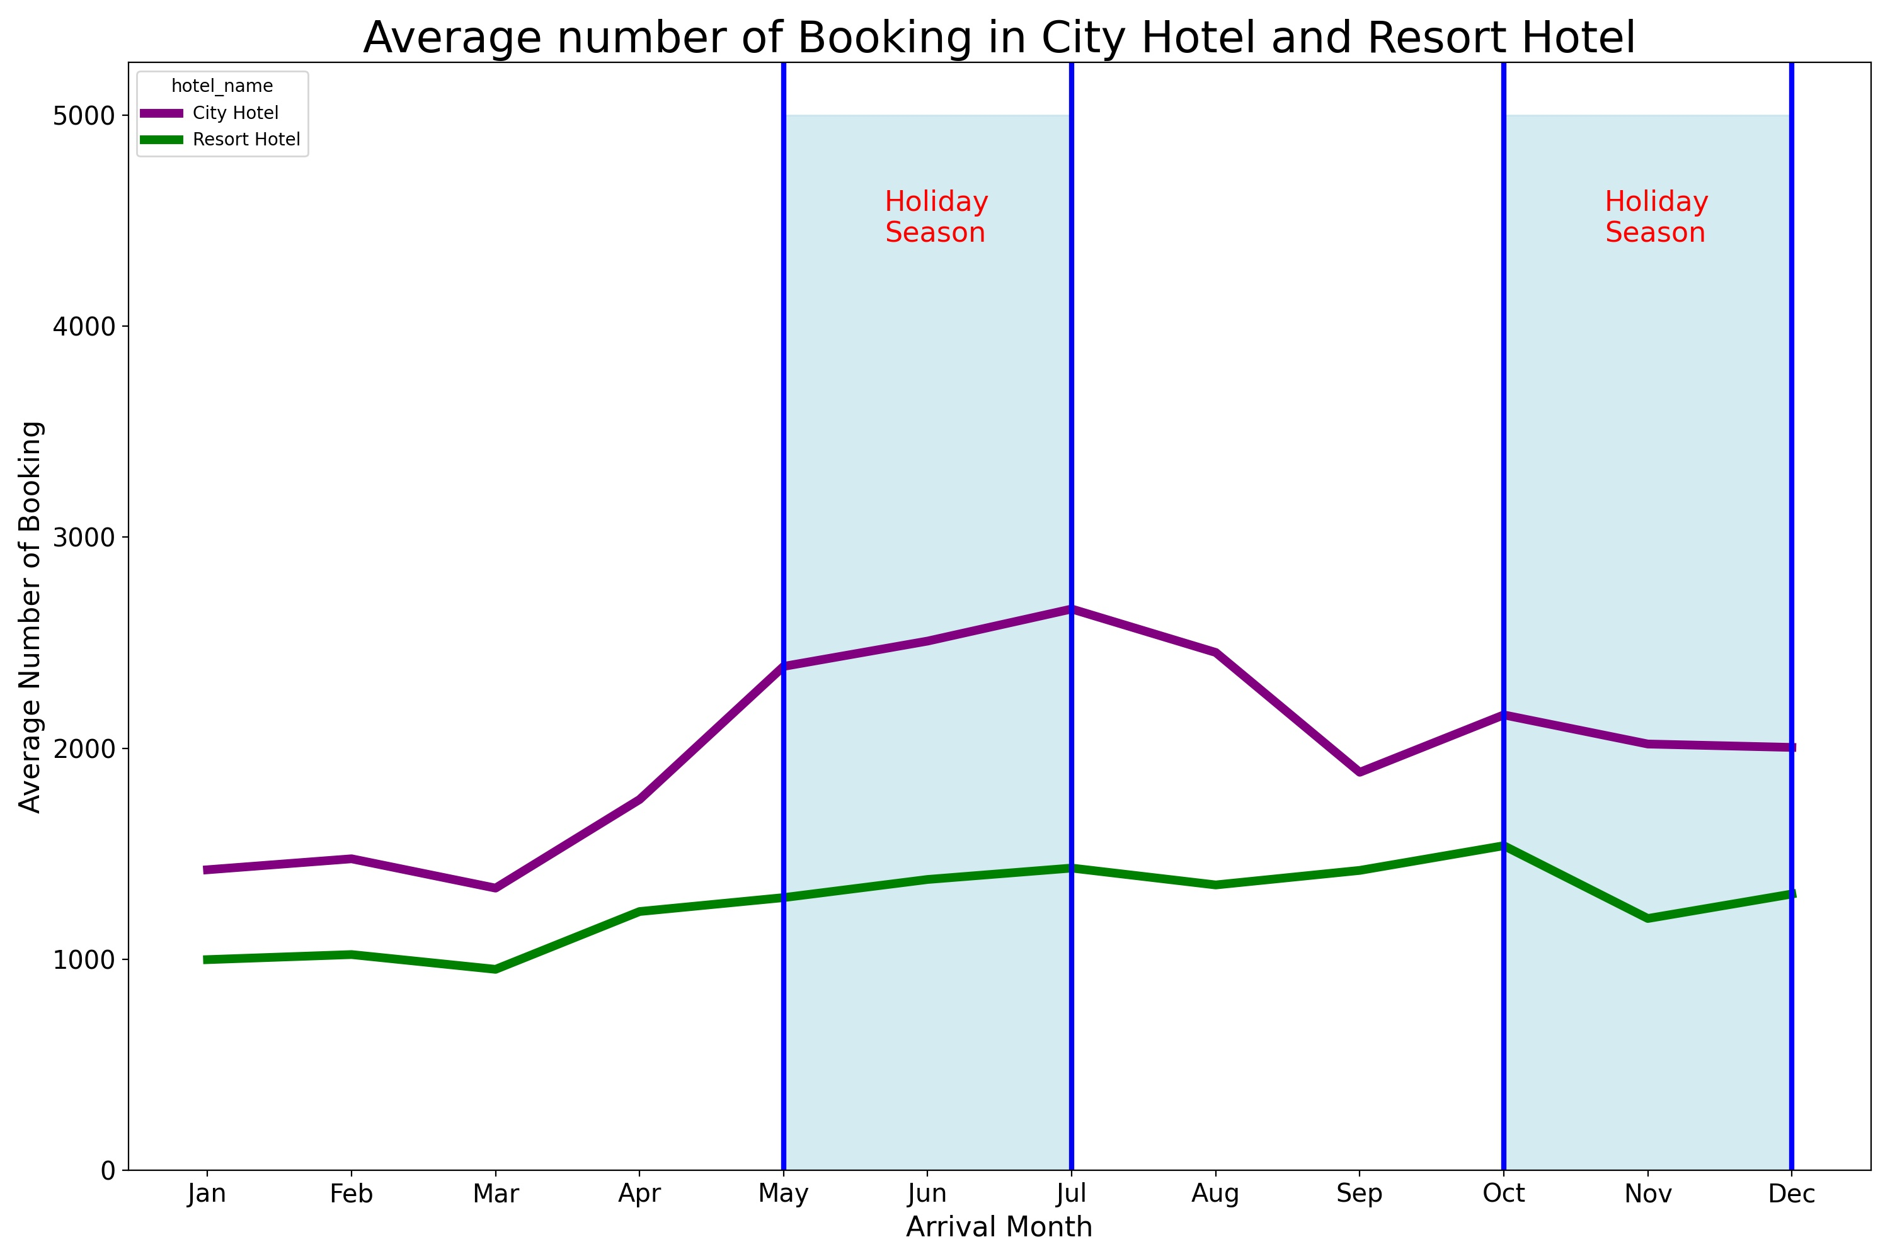
Monthly Hotel Booking Analysis Based on Hotel Type
From this picture, that we know there are two hotel, there are City Hotel and Resort Hotel.
When it is in holiday season, both of them get a more number for booking, but in November both of them have more less booking.
In September, City hotel decreased. In the other hand, Resort Hotel increase.
Both of them have a low booking in January until March.

Slide 6
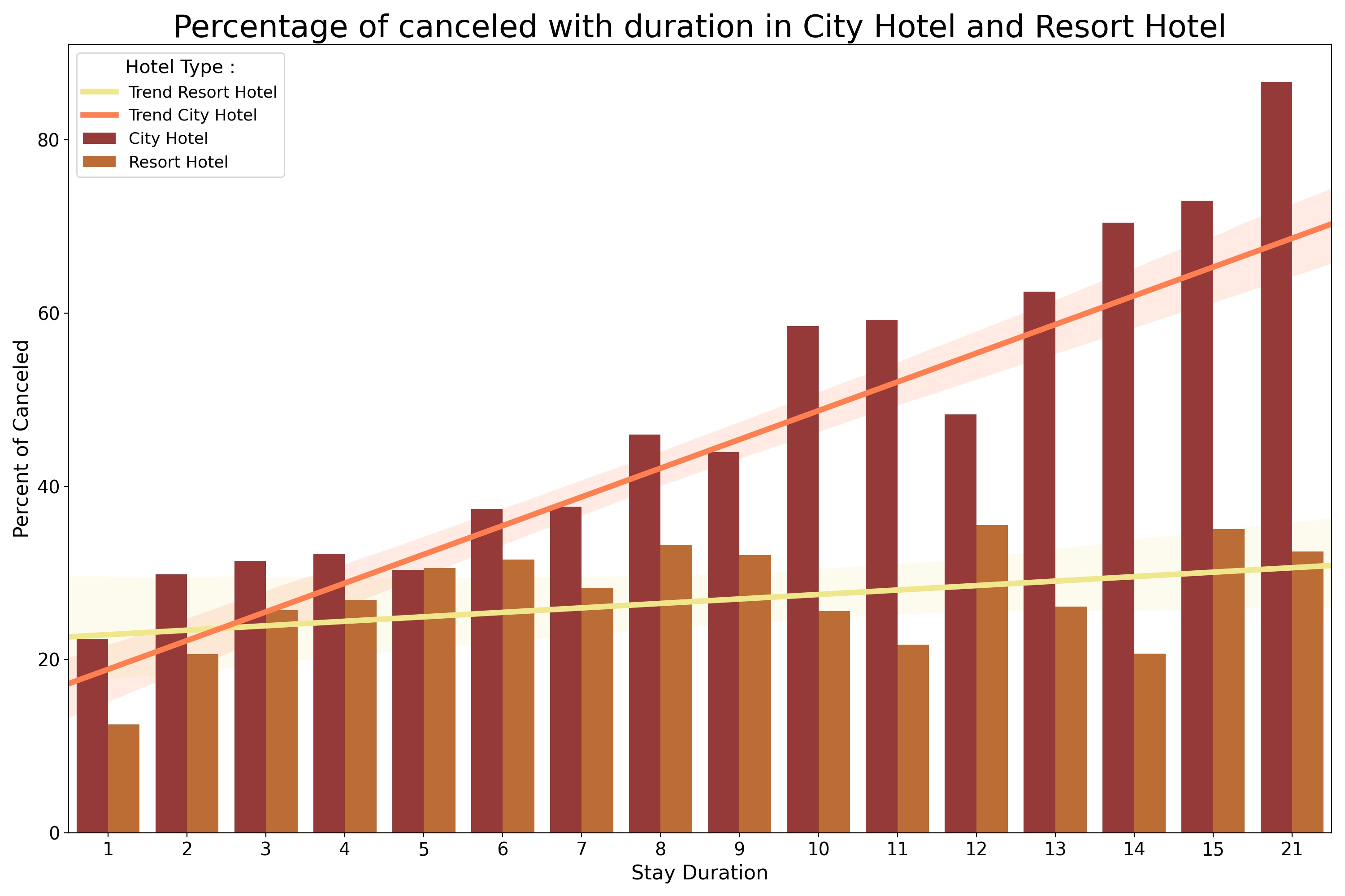
Impact Analysis of Stay Duration on Hotel Bookings Cancellation Rates
In that picture, can tell about relationship of percentange canceled with stay duration in two hotel.
In the City Hotel, the longer you stay the highest you got canceled. In the other hand, Resort Hotel not so.
For 5 days of stay, both of hotel have the same percent canceled.
The trend of Resort Hotel tends to be flat while Trend City Hotel tends to rise.

Slide 7
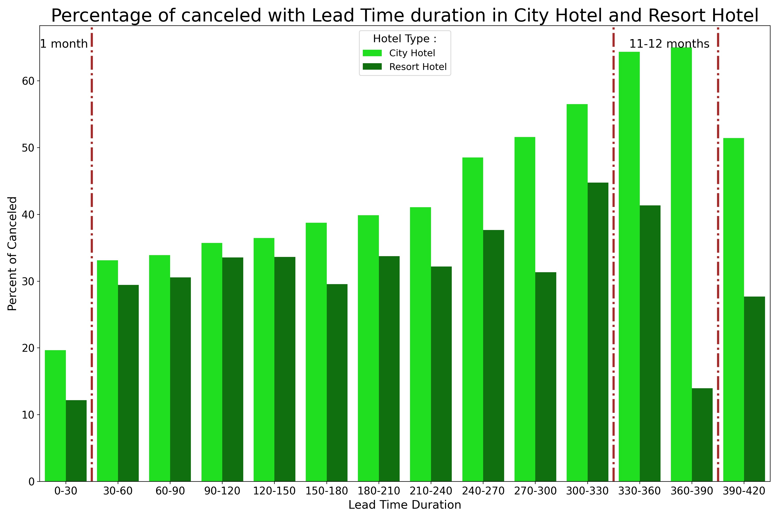
Impact Analysis of Lead Time on Hotel Bookings Cancellation Rate
In that graph, there are relationship lead time duration with percentage of Canceled in City Hotel and Resort Hotel.
With the first month, both of the hotel have a lowest canceled.
In 11-12 months period, City Hotel have reach the highest percentage Canceled. In the other hand, Resort City get the low percentage canceled in the end of 12 months.
City Hotel tends to rise until 12 months but then down in the next periods. Resort Hotel have a volatile graph for the Lead Time Duration.

